Slide 1
Biomimetic Robotic Fish
James Brooks - Project Manager
Nathan Servis - Document Manager
Abdulrahman Alnebari - Budget Liaison
Shuaib Alshuaib - Website Developer

Slide 2
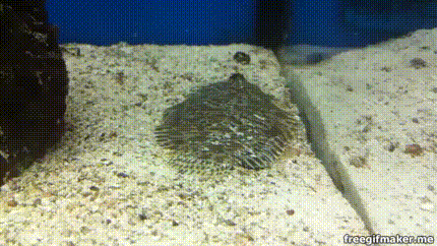
Project Description: Client & Goals
Client Info:
Dr. Alice C. Gibb
Biology Professor
Project Objective:
Build test equipment which can mimic the reactions needed to force water into sand -- a process called fluidization
Importance:
Self-burying anchor
Burying underwater drones
Figure 1: Flounder burying itself in sand [1]]
Servis

Slide 3
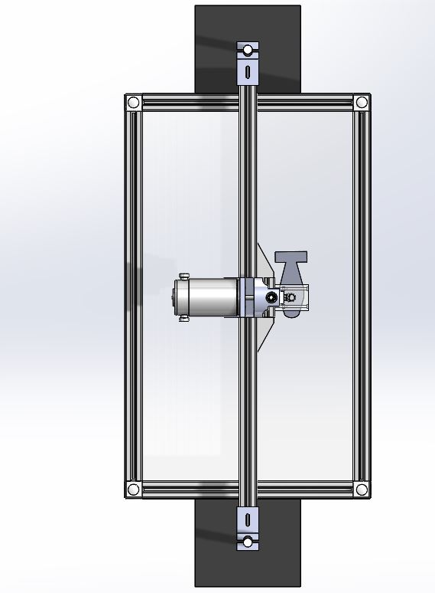
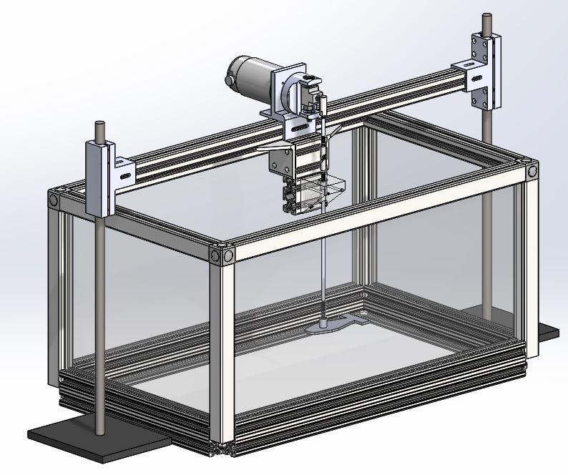
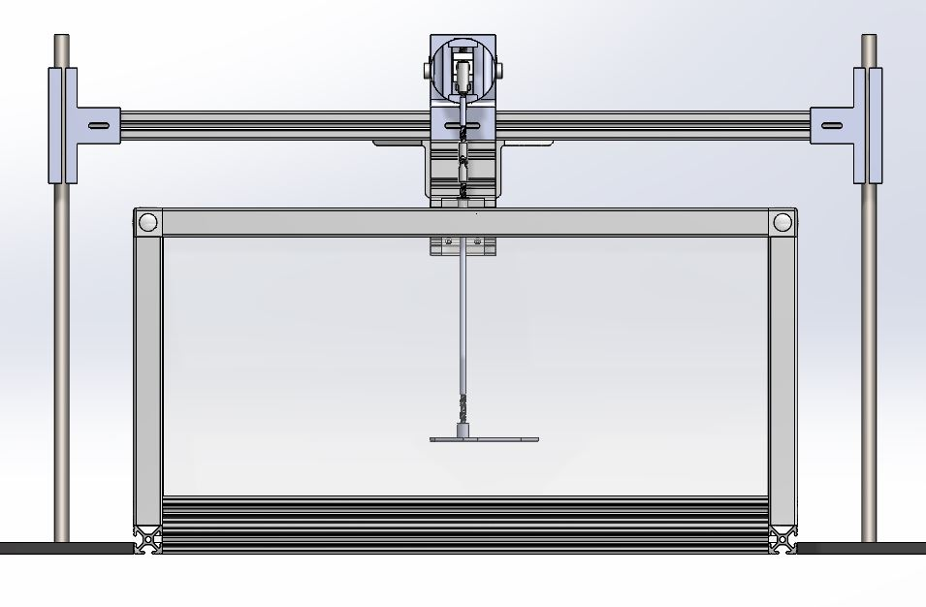
Our design
Put full cad here isometric or what looks best
Fig 3. Top View [2], [3]
Fig 2. Isometric View [2],[3]
Fig 4. Front View [2], [3]
Brooks

Slide 4
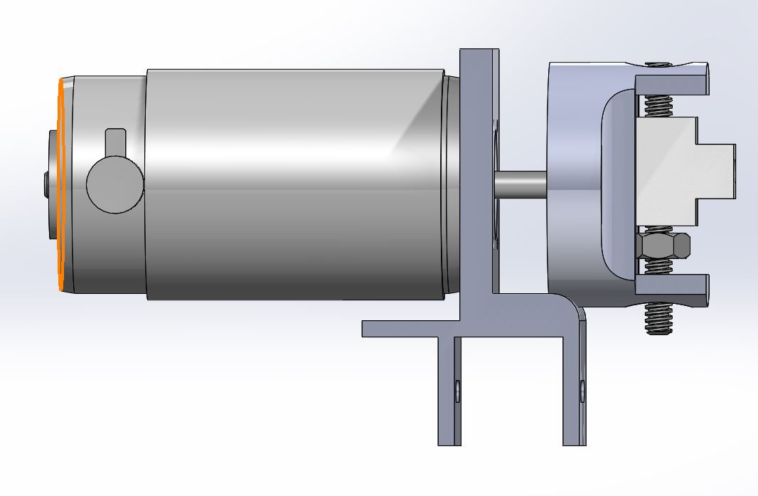
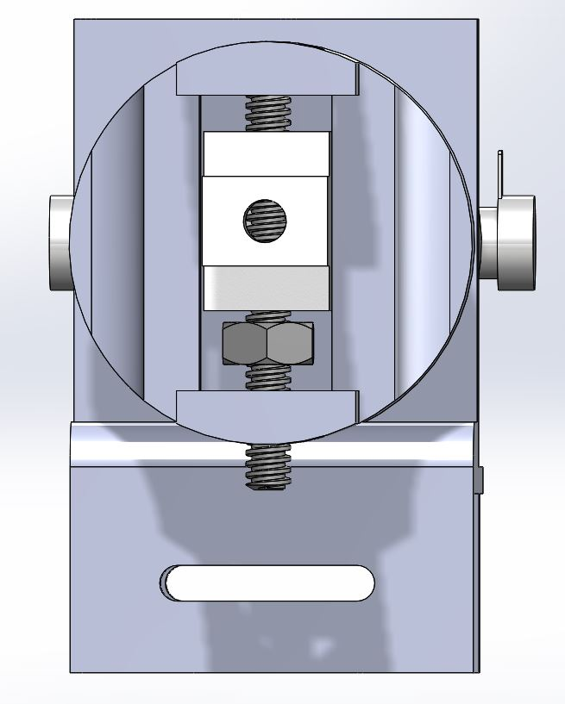
Amplitude adjustment
Manually adjust the amplitude
Allows for amplitude of 0 - 25mm
Self-Locking
Fig 4. Left Profile of Attachment Sub-Assembly [2]
Fig 6. Front Profile of Attachment Sub-Assembly [2]
James

Slide 5
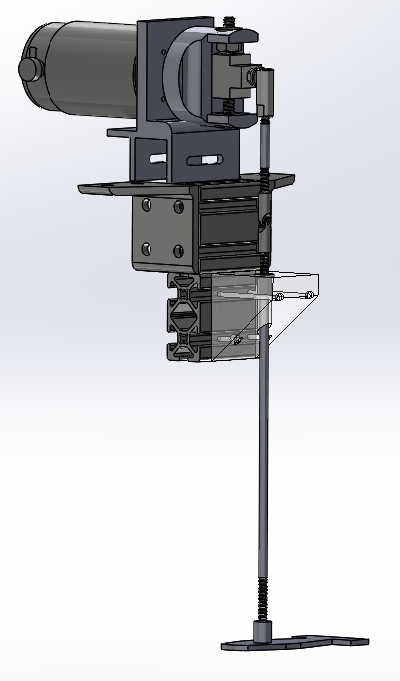
Rotational to Linear device
Crank-slider mechanism
Allows for pure linear motor while using a motor.
T-Slots and 8020 External Hardware
High Temperature Resin
Fig 7. Motor Sub-Assembly [2], [3]
Brooks

Slide 6
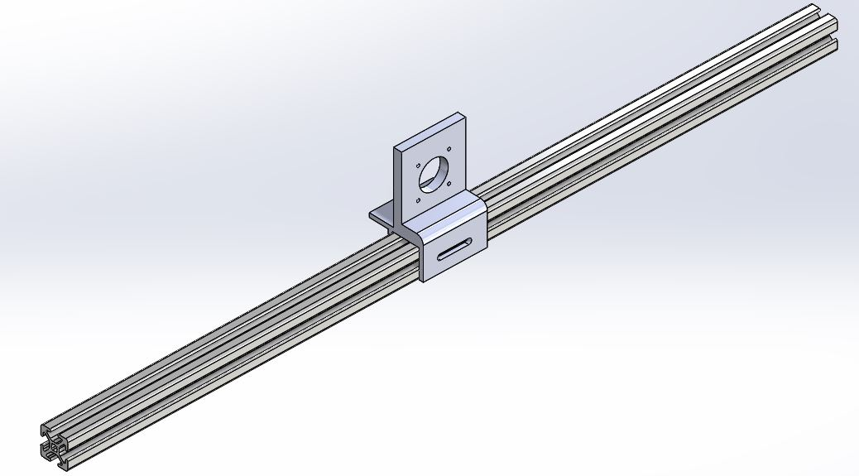
1-D Movement
Allows for easy adjustment of specimen
Shows the movements at different positions in the tank
Provides platform to attach panels
Provides Platform to attach Belt
Fig 8. Motor Mount Sub-Assembly [3]
Brooks

Slide 7
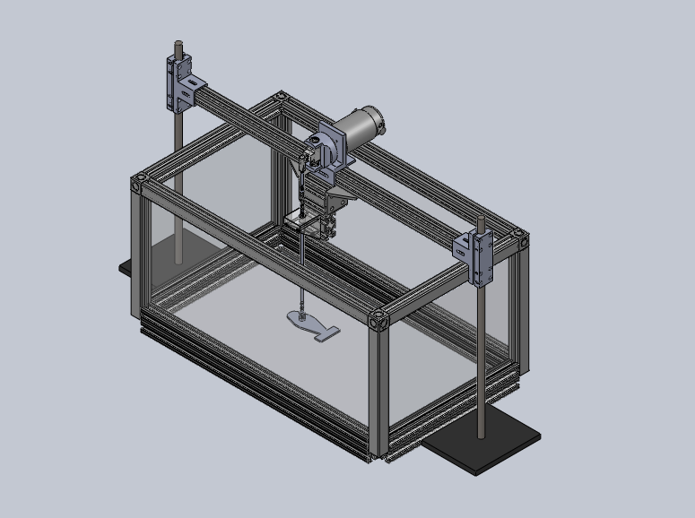
Customer Requirements (CR)
CR
Variable Oscillation [1]
Variable Sizes [2]
Biomimetic [3]
Durable [4]
Arduino Controlled
Consistency
[1]
[2]
[3]
[4]
Fig 9. Isometric View [2],[3]
Alshuaib

Slide 8
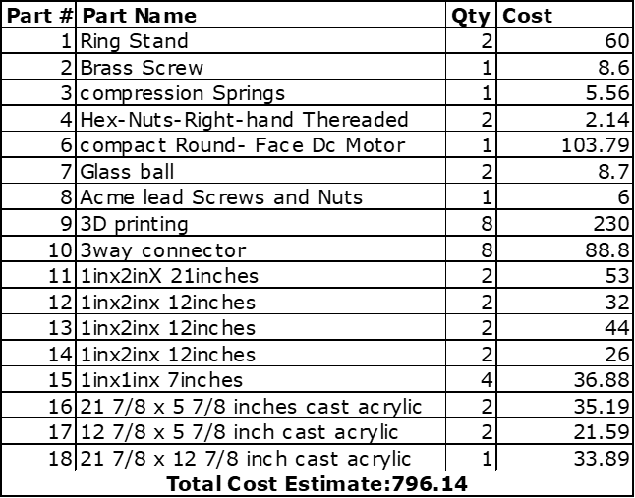
Budget
We estimate a budget of $800.00
3D printer use will be sponsored by Poba Medical
Alnebari
Notes:
The total budget came out to around $800. Our budget was brought down with help from pobo medical. Most products can be bought from McMaster Carr

Slide 9
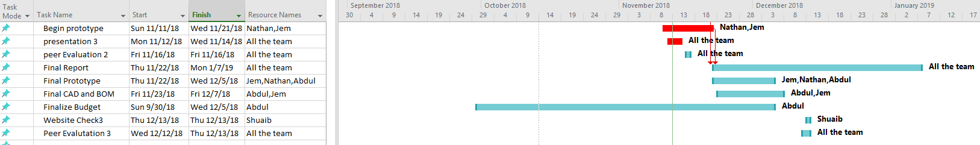
Gantt Chart - currently on schedule
Alnebari
Notes:
Our gannt chart for the current semester is in schedule! Our upcoming project has kames working on cad while Nathan works in prototypes we are all working together on the report

Slide 10
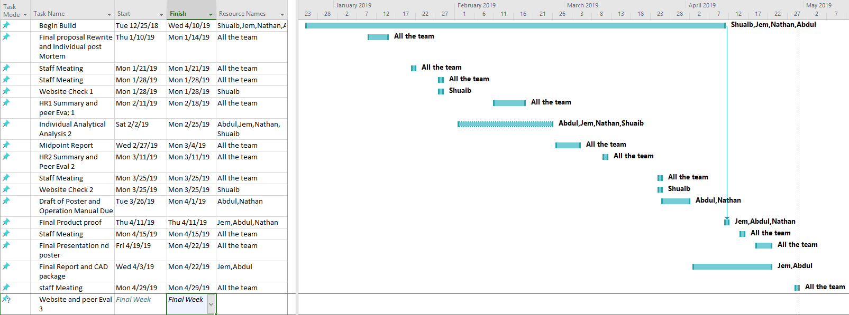
Next Semester
Gantt Chart for next semester.
Alnebari
Notes:
For the next semester the team plans to work over the winter, show in the chart we have Nathan and James working on arduino connections to the motors

Slide 11
References
[1] “Richmondreefer”, YouTube, 05-Jun-2012. [Online]. Available: https://www.youtube.com/watch?v=0HDH9pox1j4. [Accessed: 17-Oct-2018].
[2]M. S. Company, 6 November 2018. [Online]. Available: https://www.mcmaster.com/[Accessed 6 November 2018].
[3]8. I. E. Set. [Online]. Available: https://8020.net/. [Accessed 6 November 2018].
[4]"Frequently Asked Questions", Hogoballs.com, 2012. [Online]. Available: http://hogoballs.com/?p=334. [Accessed: 12- Nov- 2018].
Servis

Slide 12

Questions?
[2]
Servis

